Slide 1

Exploratory Data Analysis
G2M insight for Cab Investment
21st November,2023
Ayo-John Oluwaseun W

Slide 2

Agenda
Executive Summary
Problem Statement
Approach
EDA
EDA Summary
Recommendations

Slide 3
Executive Summary
XYZ is a private firm in US. Due to remarkable growth in the Cab Industry in last few years and multiple key players in the market, it is planning for an investment in Cab industry and as per their Go-to-Market(G2M) strategy they want to understand the market before taking final decision.
Objective : The primary goal of this analysis is to offer XYZ, a private firm in the US, comprehensive insights into the cab industry. By evaluating factors such as profitability, customer characteristics, and city-specific trends for Pink Cab and Yellow Cab, the aim is to empower XYZ with valuable information. Ultimately, the objective is to assist XYZ in making an informed and considerate decision regarding potential investment opportunities within the cab industry.

Slide 4
Problem Statement
The problem is the need for a thorough informed analysis of two cabs for near accurate recommendations to make the right decisions for suitable investments.

Slide 5
Approach
The approach used includes:
Data cleaning : This includes merging of the ‘Cab_data.csv’, ‘Customer ID.csv’, ‘Transaction ID.csv’ and ‘City.csv’ datasets into one ‘Final_joined_data .csv’.
Assumptions :
Outlliers : The outliers include the ‘Date of Travel’ , ‘Users’, ‘Population ’ columns. These were dropped from the final dataset.
Each unique Transaction ID was treated as a successful cab ride.
Each unique customer Id represents a customer.
The profit column was created by subtracting each unique ‘Cost of Travel’ from the corresponding ‘Price charged’.
These brought the total observations to 282,193 and the total features to 17.

Slide 6
Exploratory Data Analysis(EDA)
Exploratory Data Analysis (EDA) is the process of visually and statistically exploring a dataset to understand its patterns, distributions, and potential insights. It's like peeling back the layers of data to reveal its story, helping us make informed decisions and draw meaningful conclusions.

Slide 7
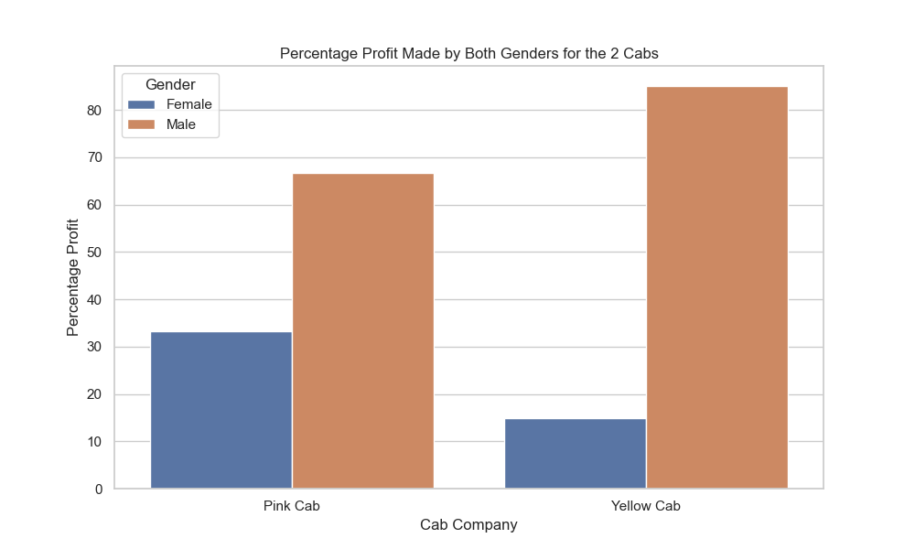
Gender based Analysis
The Pink Cab has a more balanced profit distribution between genders, with females contributing 33.24% and males contributing 66.76%.
The Yellow Cab, however, shows a significant gender-based profit disparity, with females contributing only 14.96%, while males contribute 85.04%.

Slide 8
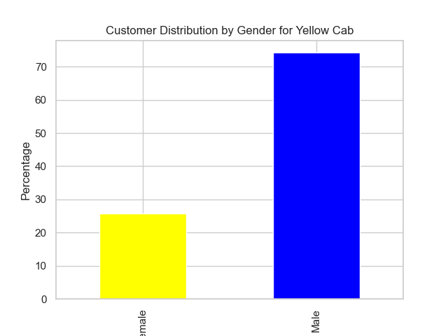
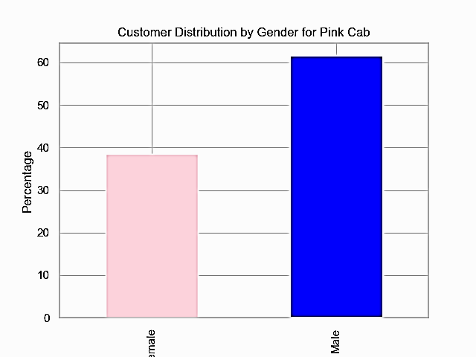
Gender based Analysis contd
Similar to the profit distribution, the Pink Cab has a more balanced gender distribution among customers, with females constituting 38.49% and males constituting 61.51%.
The Yellow Cab, on the other hand, has a lower percentage of female customers (25.80%) compared to male customers (74.20%).

Slide 9
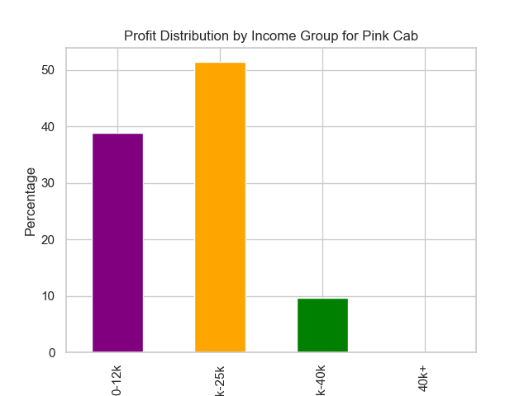

Income based analysis
Both Pink and Yellow Cabs have similar profit distribution across income groups.
The highest profit percentage is observed in the income group of 12.5k-25k, followed by the 0-12k income group.the lowest profit based on income group came from the earners of 25k to 40k.

Slide 10


Income based analysis contd
The distribution of customers across income groups is consistent between Pink and Yellow Cabs.
The majority of customers fall into the 0-12k and 12.5k-25k income groups. 25k to 40k account for the lowest customer distribution.

Slide 11
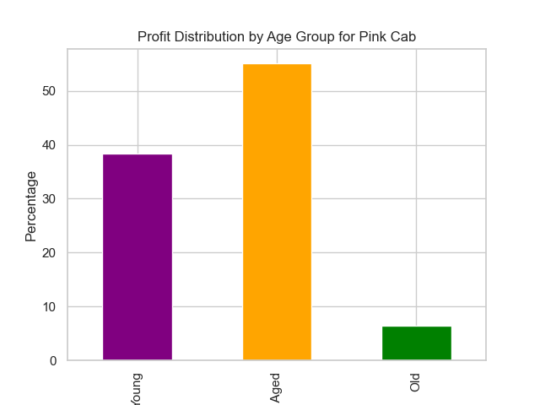

Age based analysis
Pink and Yellow Cabs exhibit similar profit distribution across age groups.
The middle-aged group contributes the most to the profits, followed by the young and old age groups. The young aged group starts from 0-25 years, the middle aged from 25-50 years old, and the old from 50 years and above.

Slide 12

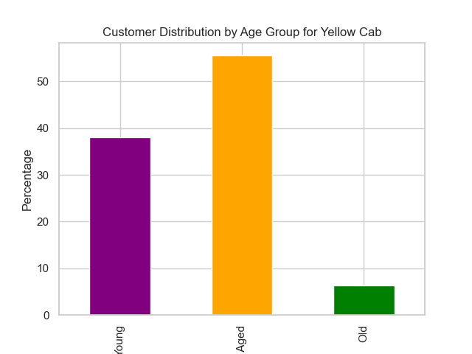
Age based analysis contd
Customer distribution across age groups is consistent for both cab companies.
The middle-aged group constitutes the highest percentage of customers, followed by the young and old age groups.
The young aged group starts from 0-25 years, the middle aged from 25-50 years old, and the old from 50 years and above.

Slide 13
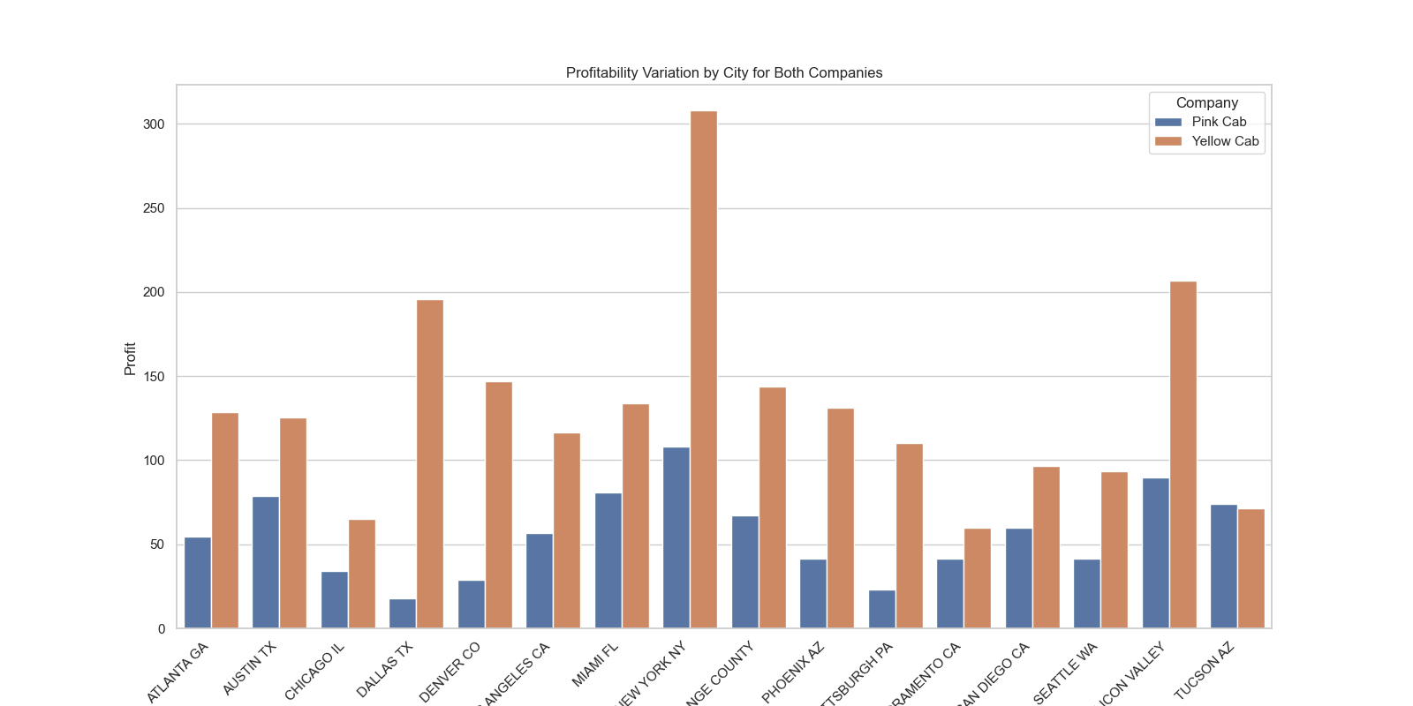
City based analysis
New York NY stands out as the most profitable city for both Pink and Yellow Cabs, contributing significantly to their overall profits.
Other cities contribute to varying degrees, but New York NY dominates. Pittsburgh has the lowest customer patronage for both cabs, but Yellow cab still dominates Pink cab.

Slide 14
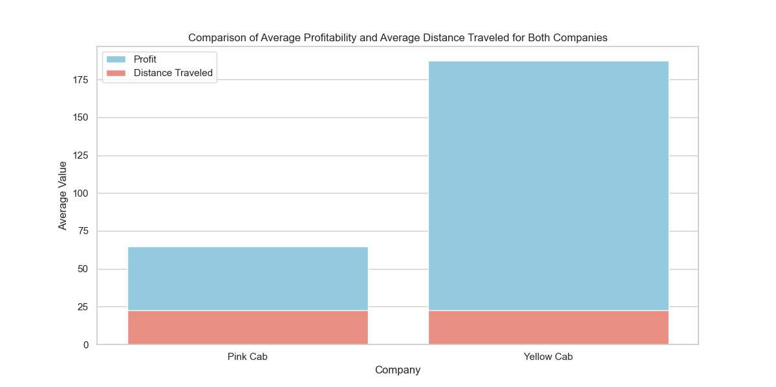
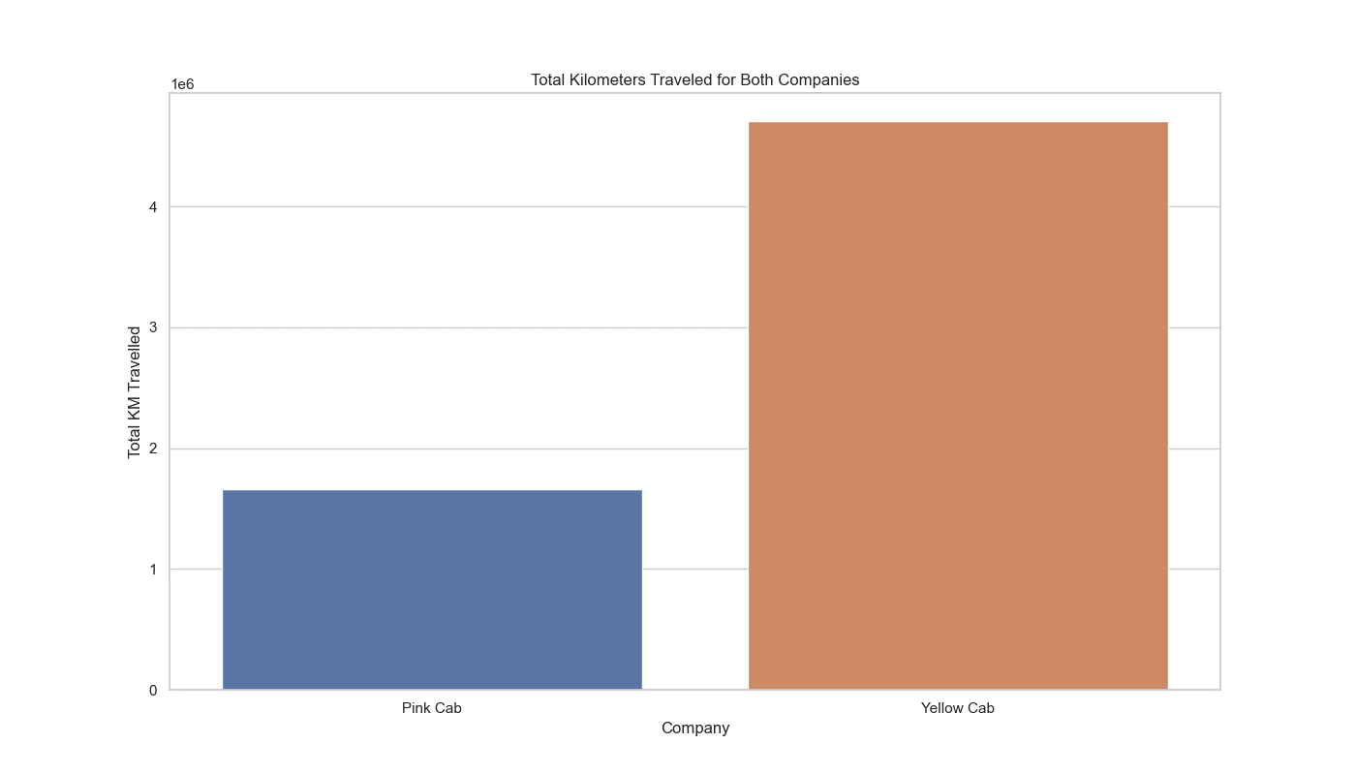
Distance based analysis.
Yellow cab has covered more distance in total(4705682.45)km than the Pink Cab(1659909.11)km, meaning customers prefer to travel longer distances with the Yellow Cab.

Slide 15
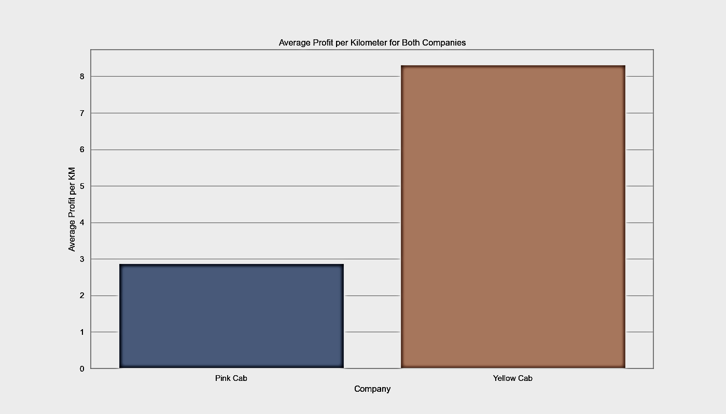
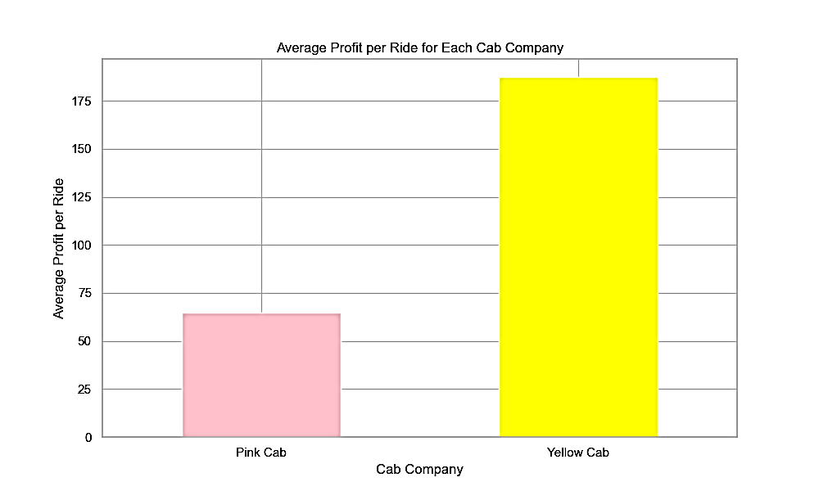
Distance based analysis contd
Yellow cab also generates more profits per km(8.306986)$ per km than the pink cab.
(2.877827)$ per km
It also betters its rival, the pink cab in average profit per ride
(187.400396) for the Yellow cab to
(64.902195) for the Pink cab

Slide 16
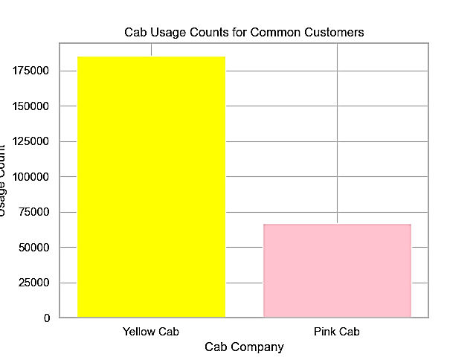
Common customer analysis
The determination of which cab the common customers prefer is based on the usage counts for each cab among these customers. The counts indicate how many times each cab was used by the common set of customers. In this case:
Cab Usage Counts for Common Customers:
Total common cab users :20,997
Yellow Cab: 185,308
Pink Cab: 66,730

Slide 17
EDA summary
Exploratory Data Analysis (EDA) Analysis:
% Profit by Gender
The Pink Cab has a more balanced profit distribution between genders, with females contributing 33.24%, and males contributing 66.76%.
The Yellow Cab shows a significant gender-based profit disparity, with females contributing only 14.96%, while males contribute 85.04%.
% Customer Distribution by Gender:**
Similar to the profit distribution, the Pink Cab has a more balanced gender distribution among customers, with females constituting 38.49%, and males constituting 61.51%.
The Yellow Cab, on the other hand, has a lower percentage of female customers (25.80%) compared to male customers (74.20%).
% Profit by Income Group:
Both Pink and Yellow Cabs have similar profit distribution across income groups.
The highest profit percentage is observed in the income group of 12.5k-25k, followed by the 0-12k income group.

Slide 18
EDA summary
Customer Distribution by Income Group:
The distribution of customers across income groups is consistent between Pink and Yellow Cabs.
The majority of customers fall into the 0-12k and 12.5k-25k income groups.
% Profit by Age Group:
Pink and Yellow Cabs exhibit similar profit distribution across age groups.
The middle-aged group contributes the most to the profits, followed by the young and old age groups.
% Customer Distribution by Age Group:
Customer distribution across age groups is consistent for both cab companies.
The middle-aged group constitutes the highest percentage of customers, followed by the young and old age groups.

Slide 19
EDA summary
% Profit by City:
New York NY stands out as the most profitable city for both Pink and Yellow Cabs, contributing significantly to their overall profits.
Other cities contribute to varying degrees, but New York NY dominates.
% Customer Distribution by City:
New York NY also has the highest customer distribution for both cab companies, reflecting the correlation between the number of customers and profits.
Total Km Traveled:
Yellow Cab has a significantly higher total distance traveled compared to the Pink Cab.

Slide 20
EDA summary
Average Profit per Km:
Pink Cab has a lower average profit per kilometer compared to the Yellow Cab.
Average Profit per Ride:
Similar to the total profit, Yellow Cab shows a higher average profit per ride compared to the Pink Cab.
Customer Usage Across Both Cabs:
Approximately 20,997 customers use both Pink Cab and Yellow Cab.
Customer Preference Among Common Users:
Cab Usage Counts for Common Customers:
Yellow Cab: 185,308
Pink Cab: 66,730
The significantly higher count for Yellow Cab suggests that, among the common customers, Yellow Cab is used more frequently than Pink Cab. Therefore, the conclusion is drawn from the observation that Yellow Cab has a higher usage count among this specific group of customers.

Slide 21
Recommendations
Based on the analysis of the data provided, I recommend investing in Yellow Cab.
Higher Profitability:
Yellow Cab demonstrates a consistently higher average profit per ride and per kilometer compared to Pink Cab. This suggests better revenue generation and potential for higher returns on investment.
Market Dominance:
Yellow Cab has a significant presence in key markets, especially in cities like New York NY, where it exhibits substantial profitability. Investing in a market leader can provide stability and opportunities for growth.
Diverse Customer Base:
Despite some gender-based profit disparity, Yellow Cab has a broader customer base across income groups and age groups. This diversity may contribute to a more resilient business model.
Potential for Optimization:
With a larger customer base and higher total distance traveled, Yellow Cab has room for potential optimization of operations and services, which could further enhance profitability.
Strategic Growth Opportunities:
The strong performance in New York NY indicates a strategic market presence. The XYZ team can explore opportunities for further growth in this key market and potentially replicate successful strategies in other cities.

Slide 22
Thank You

